Slide 1
Dealing with Unstructured data
Divya Choudhary

Slide 2
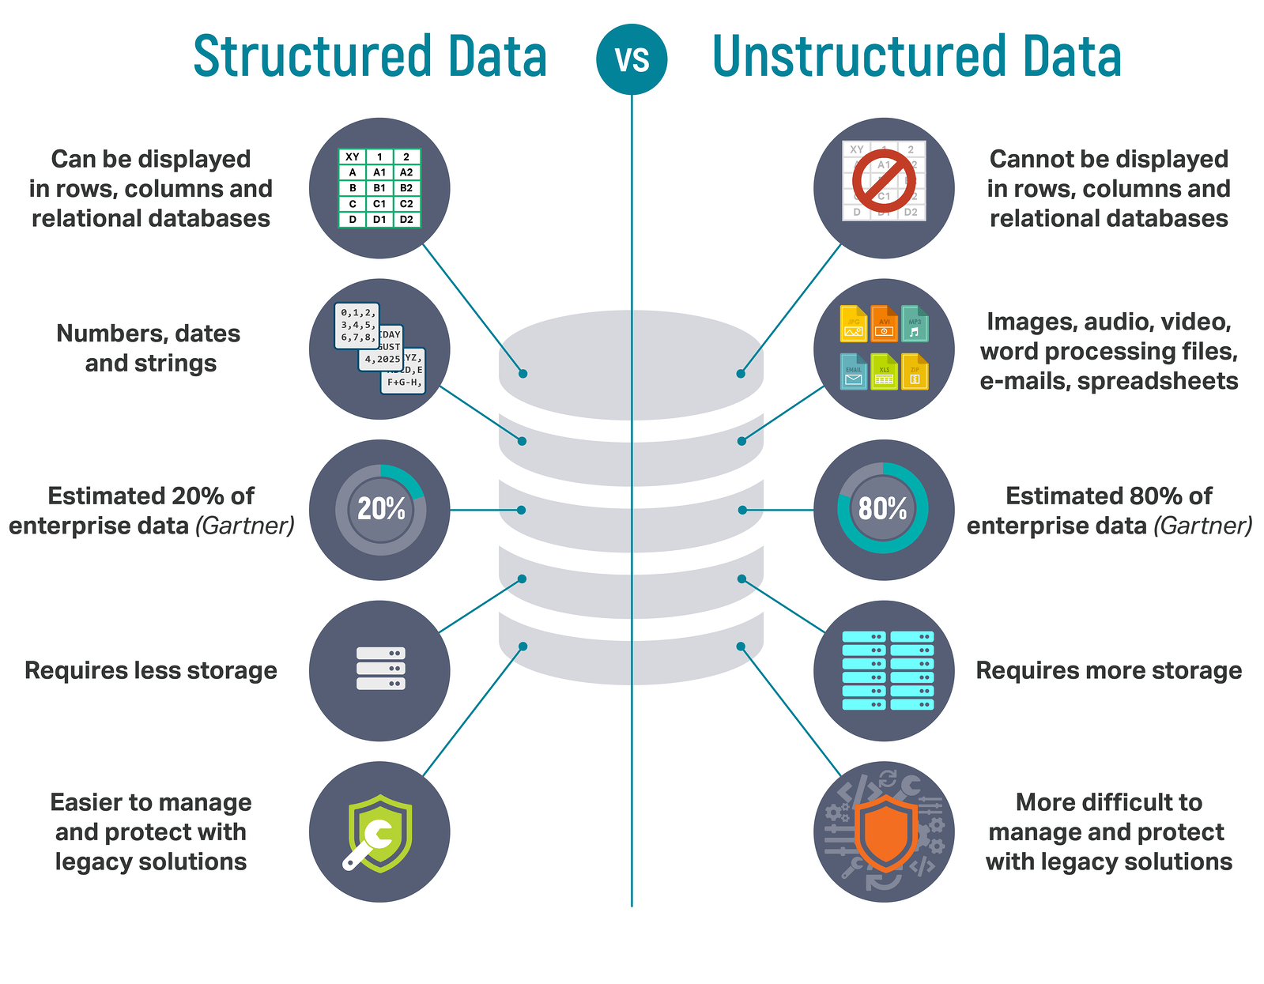
Notes:
Test speaker notes

Slide 3
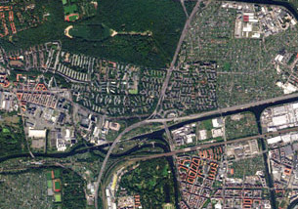
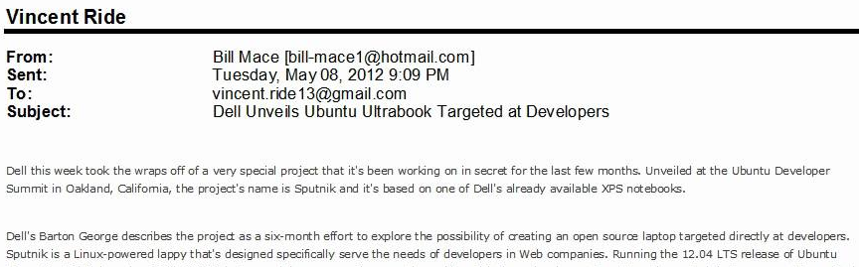
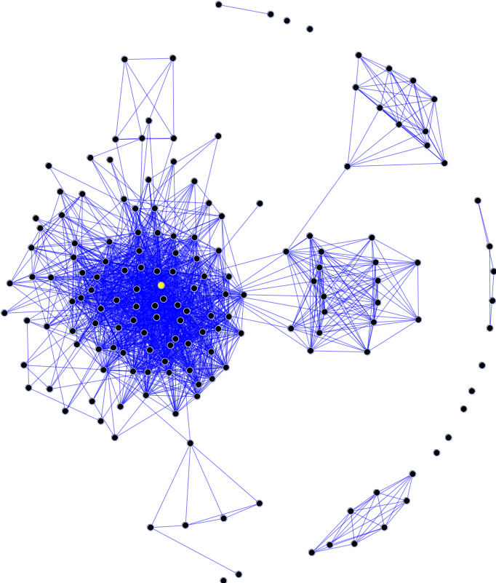
Examples of Unstructured data
Image/Video/Speech
Storage | Mathematical Representation
Store images and videos on fast file system. Organize metadata (names, descriptions, links) in Relational DB Convert Speech to text and store as text | Pixel matrix
NoSQL DB Eg. MongoDB | Word embeddings, TFIDF
Graph Database Eg. Neo4j, Hierarchical Tables in SQL | Node connections, Link strengths
Text
Graphs
Notes:
Test speaker notes

Slide 4
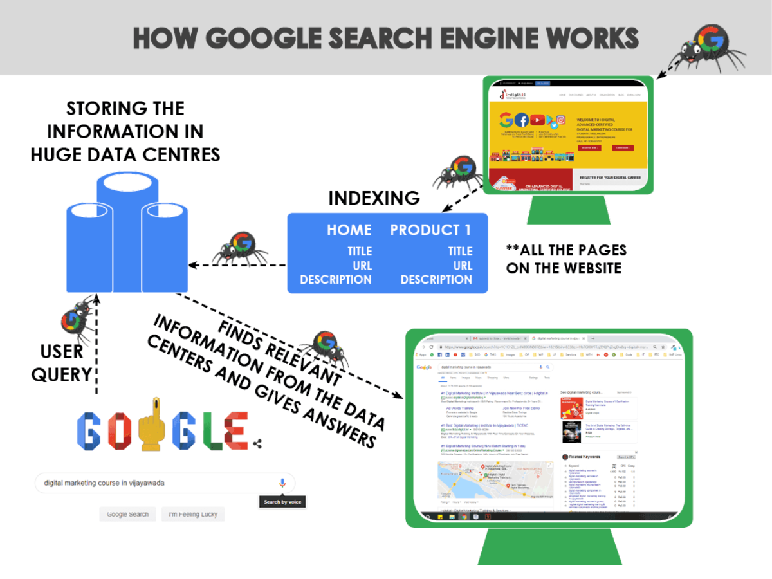
Text
Google is the best search engine
Power of indexing
Spell correction example
Source

Slide 5
Demo - Building our own tiny Search engine
Using SQL Free text search

Slide 6
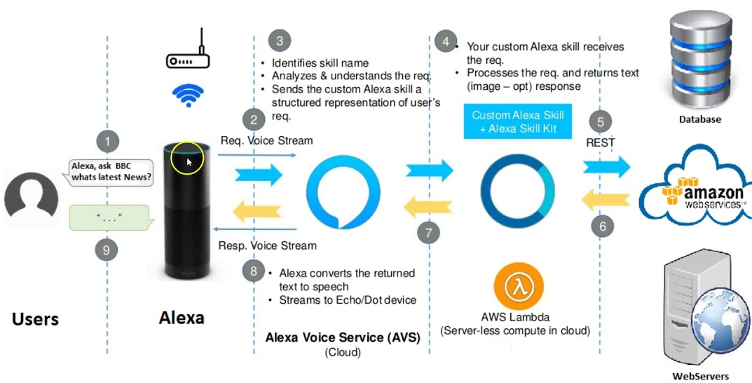
Voice
Source

Slide 7
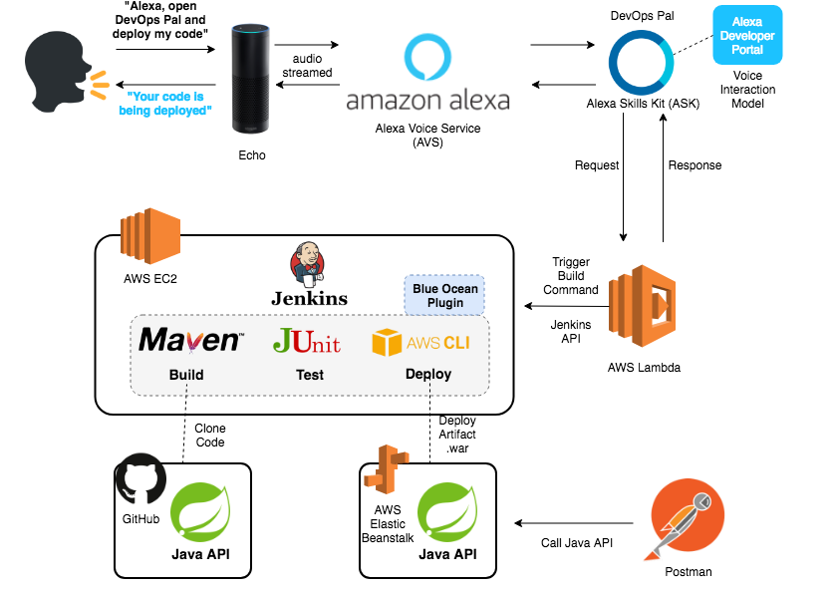
Voice
Source

Slide 8

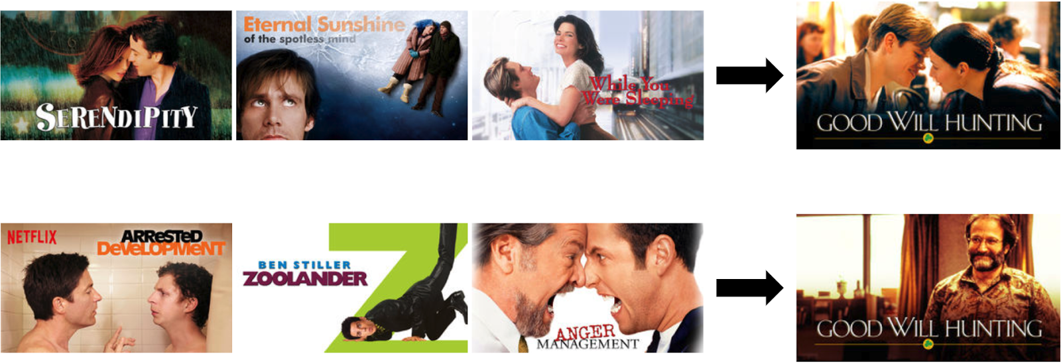
Netflix Recommendation engine
- Artwork personalization

Slide 9
Thank You

